Slide 1
SDL Recommendations
Osvaldo Calles

Slide 2
Topics
Security Education
The Security Push
Bug Tracking
Communication
Final Security Review

Slide 3

Security Education – The basics
Review checkers
Support false positive identification
Assess security risks
Recommend new checkers
Research new tools and methodologies
Overview of Trustworthy Computing
Short introduction to SDL
Basic of Secure Design
Attack Surface Reduction
Defense in depth
Least Privilege
Secure Defaults
Threat Modeling
Designing to Threat Model
Coding to Threat Model
Testing to a Threat Model
Introduction to Fuzz Testing
Secure Coding Best Practices
Buffer overruns
Integer Arithmetic Issues
Cross-site Scripting
SQL Injection
Weak Cryptography
C/C++ issues
Notes:
curso de Secure Coding Best Practices

Slide 4
Security Education - For the team
Each member in the
Security group should
Be the owner of a component
For all Operating Systems.
Group as a team, so each member can manage a product. Technical leaders
Programming
Debugging
Product Knowledge
Penetration testing
Notes:
Secure Code Review

Slide 5

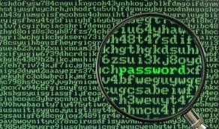
Security Education – In-Depth
Review checkers
Support false positive identification
Assess security risks
Recommend new checkers
Research new tools and methodologies
The Basics of Secure Software Design, Development, and Testing
Fuzz Testing in Depth
Threat Modeling in Depth
Implementing Threat Mitigations
Security Design and Architecture: Time-Tested Design Principles
Introduction to the SDL and Final Security Review (FSR) Process
Security Tools Overview
Performing Security Code Reviews
Secure Coding Practices
Security Bugs in Detail
Attack Surface Analysis (ASA) and Attack Surface Reduction (ASR)
Exploit Development
Build Requirements
Security Response
Cryptography by example
Customer Privacy

Slide 6

Security Education - How to Get More Knowledge ?
Attendance at a security conference
Security vendor presentation
Providing security training
Publication of a security article
- SWPC
- ??
Notes:
Entrenamiento para hacer documentacion
Security Conference

Slide 7

Security Education - Providing Security Training
Factors that affect the cost of SDL.
Training helps to reduce the cost of security. This might sound obvious, but it’s still worth emphasizing: an effective training program will motivate your designers and developers to produce more secure software in the first place. The code reviews, tools, and testing will find fewer problems, and implementing the SDL will be quicker and cheaper.
- Create an expertise and give training to developers around the product in other groups.
- Hunt for security bugs, build threat models, and perform basic penetration testing.

Slide 8
Security Education - Providing Security Training (cont.)
General path that we follow for developing a new class:
Objectives and target audience are determined for the class.
A security expert builds the new class.
Other experts review the class material for technical accuracy and applicability.
Training (not security) experts edit the class material, looking for consistency and typographical errors.
We deliver a beta class. The main goal of this class is to fine-tune timing and get feedback on content.
We update the class material with the feedback on content.
We deliver the class at least once a month for six months.
After six months, we record the class and put it on the intranet.

Slide 9
The Security Push
The main tasks during the push are as follows:
Training
Code reviews
Threat-model updates
Security testing
Documentation scrub

Slide 10
The Security Push - Security Validator Role
Review checkers
Support false positive identification
Assess security risks
Recommend new checkers
Research new tools and methodologies
Execute penetration testing.
Support false positive identification
Assess security risks
Review Checkers and recommend new checkers
Research new tools and methodologies
Communicate to KW Support issues related to false-positive or false-negatives.

Slide 11
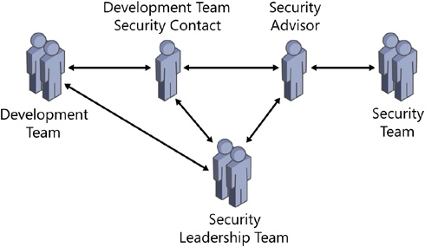
The Security Push - Security Advisor role
Review checkers
Support false positive identification
Assess security risks
Recommend new checkers
Research new tools and methodologies
Acting as a point of contact between the development team and the security team.
Holding an SDL kick-off meeting for the development team.
Holding design and threat-model reviews with the development team.
Analyzing and triaging security-related and privacy-related bugs.
Acting as a security sounding board for the development team.
Preparing the development team for the FSR.
Working with the reactive security team.

Slide 12
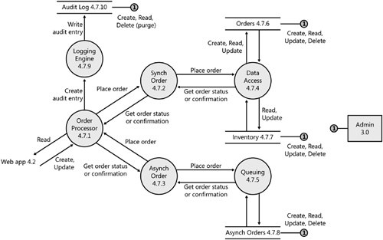
The Security Push - Risk Analysis
Review checkers
Support false positive identification
Assess security risks
Recommend new checkers
Research new tools and methodologies
If we could do only one thing to improve security – threat modeling, better security code reviews, or better security testing – we would do threat modeling every day of the week.
Threat modeling occurs early in the project lifecycle and can be used to find security design issues before code is committed.
Threat-modeling is owned by a person in the design group, who has the most security background.
Use threat model to aid code review
Use threat model to aid testing

Slide 13
The Security Push - Fuzzing Process
Review checkers
Support false positive identification
Assess security risks
Recommend new checkers
Research new tools and methodologies
SDL recommend at least 100 files of each supported file type to get reasonable coverage.
SDL mandates an absolute minimum of 100, 000 fuzzed files per format and parser. If you find a bug, the count resets to zero, and you must run 100,000 more iterations by using different random seed so that you create different malformed.
We can start pentesting any time there is enough code to make a pentest cost effective.
When fuzz testing an application, run the DriverVerifier to detect faults earlier and use a profiling tool to see if the fuzzer is working correct.

Slide 14
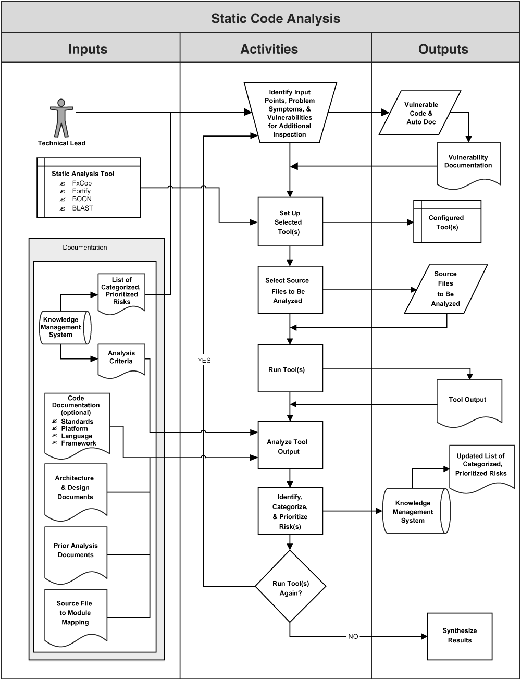
The Security Push - Static Analysis Process
Review checkers
Support false positive identification
Assess security risks
Recommend new checkers
Research new tools and methodologies

Slide 15
The Security Push - Static Analysis and CI
There isn’t ‘formal’ CI happening yet at the server level. KW is planning a formal CI feature in its ‘Eldorado’ release that will come Q2-2014. Formal CI is where scans are triggered whenever a file is checked-in.
The closest you we can come to CI on a KW Server is to do incremental scans at a high frequency.
Of course, running on-demand (pre-commit) scans with the KW Desktop Client is even better than CI, and that is possible right now…!!

Slide 16
The Security Push - Code Reviews
The first step in security code review is to build a database of all the files and assign an owner to each source code file and create a table with the following fields:
File name . The name of the file, including the directory where it’s stored.
File owner . The name of the file owner.
Priority . The priority for reviewing the code. Ratings range from 1 to 3, with 1 being the highest priority.
Reviewed by . The name of the person who will review the code. If you plan to have multiple people review the code, you might want to make this a separate table.
Reviewed . A field with only three possible values: Yes, No, and Partial.
Comments . Any comments about the file that might be of interest to people reviewing the code.
Determine review priority. Much of this identification should be driven by the threat model.

Slide 17
The Security Push - Code Review
Review checkers
Support false positive identification
Assess security risks
Recommend new checkers
Research new tools and methodologies
Based on analysis at Microsoft, at most average developer can review about 1,500 lines of C code a day or 1,100 lines of C++ code a day looking for deep security bugs. It is of course, possible to review more quickly than this, but the quality of the review might suffer.
The quality of code review, the ability to find real bugs versus finding false positives of missing bugs is proportional to the code size under review.
Understanding security bugs, if engineers do not know what constitutes a security bug, they will find none when reviewing the design of a component or the code underlying the design.
-Suggestion. One day a week every member of the team should explain one security issue.

Slide 18
The Security Push - Code Review (cont.)
Review checkers
Support false positive identification
Assess security risks
Recommend new checkers
Research new tools and methodologies
Security Checklist for Windows
Code compiled with –GS
Review Strsafe.h for potential use in your code
Review the latest update of dangerous or outlawed functions
All DACLs well formed and “good”—not NULL or Everyone (Full Control)
No hard-coded 14-character password fields (should be at least PWLEN + 1 for NULL, PWLEN is defined in LMCons.h, and is 256)
No references to any internal resources (server names, user names) in code
Security support provider calls not hard-coded to NTLM (use Negotiate)
Calls to CreateProcess[AsUser] do not have NULL as first argument if you know the full path name to the .EXE
Unauthenticated connections cannot consume large resources
Security sensitive code is commented appropriately
Check that file requests are not for devices (i.e., COM1, PRN, etc.)
No shared or writable PE segments
No user data written to HKLM in the registry
No user data written to c:\program files
No resources opened for GENERIC_ALL, when lesser permissions will suffice
Application allows binding to appropriate IP address, rather than 0 or INADDR_ANY
Exported APIs with byte count vs. word count documented
Impersonation function return values checked
For every impersonation, there is a revert
Service code does not create windows and is not marked interactive

Slide 19
Bug-Tracking
Review checkers
Support false positive identification
Assess security risks
Recommend new checkers
Research new tools and methodologies
Whenever we create a new sighting with the focus_feature as Security, we add a new field to describe better the issue:
Security/Privacy Bug Effect:
Not a Security Bug
Spoofing
Tampering
Repudiation
Information Disclosure
Information Disclosure (Privacy)
Denial of Service
Elevation of Privilege
Attack Surface Reduction
Security/Privacy Bug Cause
Not a Security Bug
Buffer Overflow or Underflow
Arithmetic Error (for example, integer overflow)
SQL/Script Injection
Directory Traversal
Race Condition
Cross-Site Scripting
Cryptographic Weakness
Weak Authentication
Weak Authorization/Inappropriate ACL
Ineffective Secret Hiding
Resource Consumption (DoS)
Incorrect/No Error Messages
Incorrect/No Pathname Canonicalization
Other

Slide 20
Communication
Review checkers
Support false positive identification
Assess security risks
Recommend new checkers
Research new tools and methodologies
Constant communication to the software development team about the progress of the security push is absolutely critical to the push success. Communication could include the following:
Regular e-mail messages from push leadership to the development team to outline progress
An intranet site with live statistics
These two forms of communication should include the following:
Number of bugs found.
Number of new bugs opened in the last 24 hours.
Number of files and amount of code reviewed, threat models reviewed, tests executed, and so on. A chart should be provided to show progress and the glide-path down to push completion. A glide-path shows how the progress statistics trend toward a finish date.

Slide 21
Communication (cont.)
Review checkers
Support false positive identification
Assess security risks
Recommend new checkers
Research new tools and methodologies
The names of the top bug hunters. Include information such as who has found the most bugs so far and who has found the most bugs in the oldest code.
Funny stories or anecdotes. Although a security push is serious business, adding a human touch makes it a little less austere.
We can use our Wiki site

Slide 22
Final Security Review (FSR)
Review checkers
Support false positive identification
Assess security risks
Recommend new checkers
Research new tools and methodologies
Unfixed Security Bugs Review
Verify that security bugs that are marked as “Won’t Fix” are appropriate to leave unfixed
Normally try to review all such bugs in less than a week, and we enroll enough security people to meet the allotted time. Don’t drag this phase out, even in the face of a large number of bugs.
Mark each bug that is reviewed as such so that you don’t go back over the same bugs time after time.

Slide 23
Final Security Review (cont.)
Review checkers
Support false positive identification
Assess security risks
Recommend new checkers
Research new tools and methodologies
Create a new field named SecAudit with the following possible values:
Untriaged
Not a security concern
Defense in depth
Low severity
Medium severity
Important severity
Critical severity
Mark all unfixed security bugs (where Security/Privacy Bug Effect < > Not a Security Bug) with SecAudit = Untriaged.

Slide 24
Missing
Review checkers
Support false positive identification
Assess security risks
Recommend new checkers
Research new tools and methodologies
The history of security bugs found in similar products.
Documentation of the product.
Train people to understand the product.
Monitor the rates and types of security bugs found during product design, development and testing.

